Slide 1
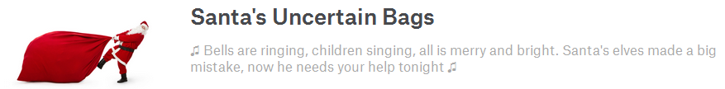
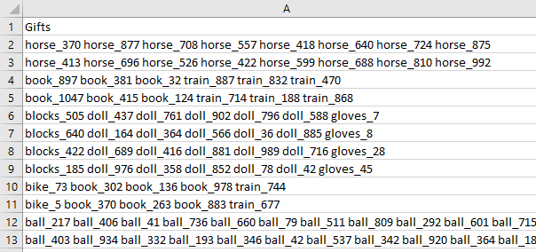
Fill 1000 bags with a selection of 9 types of gift
Objective: maximise the total weight of all bags
We know the number, mean and distribution for each type of gift, but we do not know the weight of each specific gift
Each bag must:
Have at least 3 gifts
Weigh less than 50 lbs (bags over 50 lbs are scored as 0)
Example Submission File

Slide 2
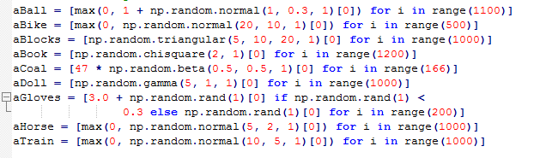
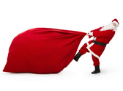
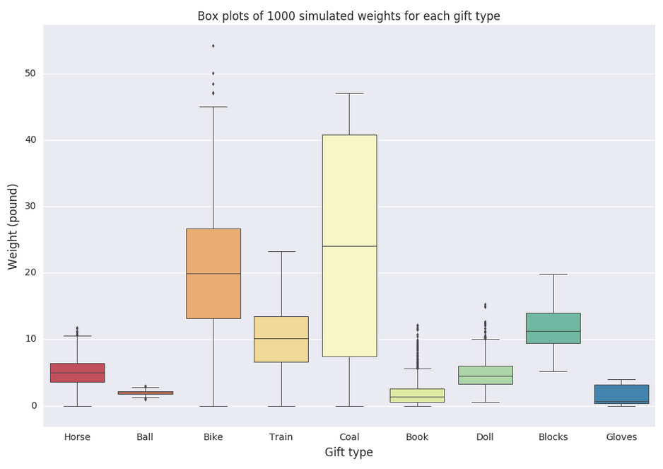
Source: Kaggle

Slide 3
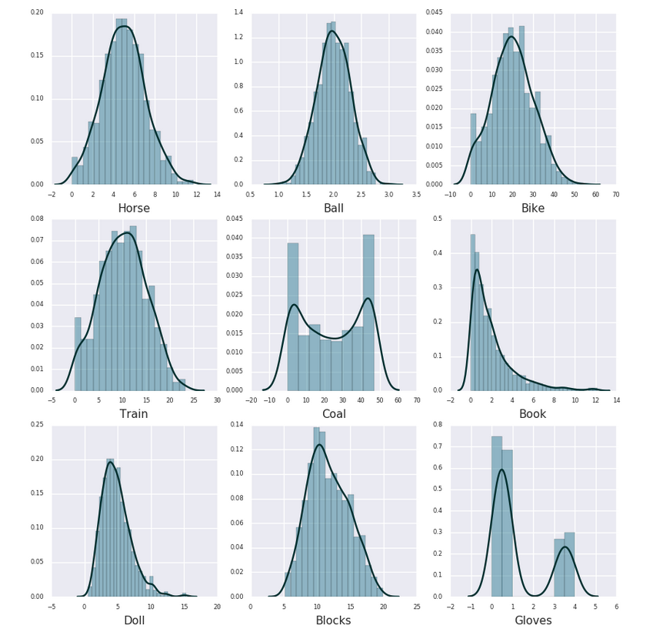
Source: Kaggle

Slide 4
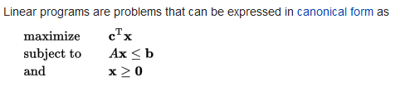
Solution involved:
Linear programming - to find the optimum gift combinations (PuLP package)
Shuffling gifts within gift type
Monte Carlo analysis to evaluate if a particular ‘shuffle’ provides a good score
Mining the Leader Board test data to:
Find bags over 50lbs and remove/exchange gifts to lower them to below 50 lbs
Find underweight bags and add gifts to increase their weight
Shuffle groups of bags to get a better score for that group
Source: Wikipedia

Slide 5
Highlights:
Great introduction to a different type of problem and fun
Great community – positive, constructive and helpful
Other thoughts:
Competitions have faults. Seed was discoverable
Competition versus Learning
Next time I would:
Start mining the Leader Board as soon as possible

